Slide 1
Online Ranking System
Implementing Rankings with Sorting Logic
Kevin Chen

Slide 2
Project Overview
Objectives and Goals:
Develop a ranking system to sort players based on common league metrics
Implement file persistence to maintain player data between sessions.
Provide a basic interface for interactive usage.
Project Scope:
Implement an efficient sorting algorithm (merge sort) for real-time ranking.
Include functionality to update player scores based on match outcomes.
Allow user interactions for adding players, viewing rankings, and saving/loading data.

Slide 3
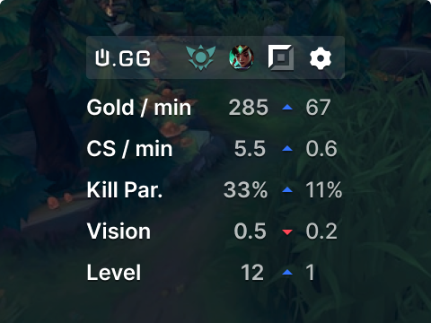
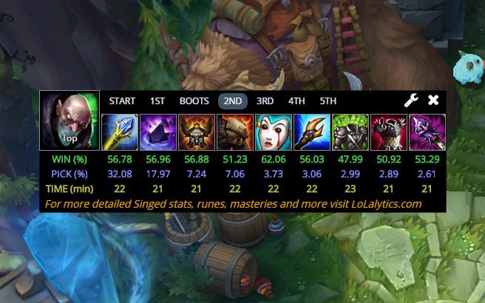
Literature Review
Summary of Relevant Existing Work:
Many different existing sites that focus on different things
U.gg focuses on UI and lolalytics presents more raw data
Relation of Your Project to Previous Work:
A much more basic version of both.
Sites such as these have access to Riot’s API, which means more accessible data

Slide 4
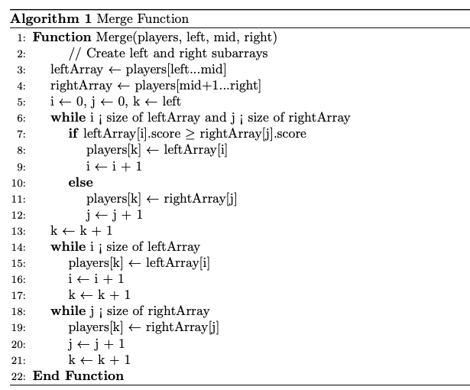
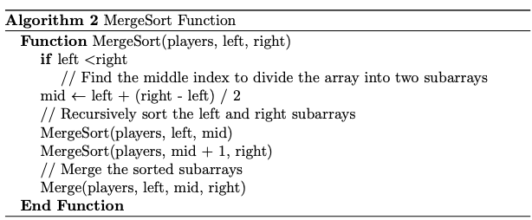
Methodology
Description of Methods and Techniques Used:
Merge Sort: Efficient O(n log n) sorting algorithm chosen for stability and performance.
File Persistence: Uses ifstream and ofstream from <fstream> for saving/loading player data.
CLI User Interface: Enables players to view, update, and manage rankings interactively.
Pseudo Code for Techniques Used:
Merge:
Merge sort:
Time Complexity Estimation:
Merge: The space complexity for merging two subarrays of size n is O(n).
Merge Sort: O(n log n) for sorting players, making it suitable for large player lists.

Slide 5
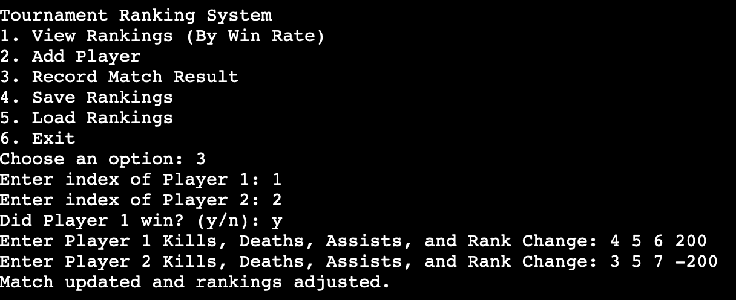
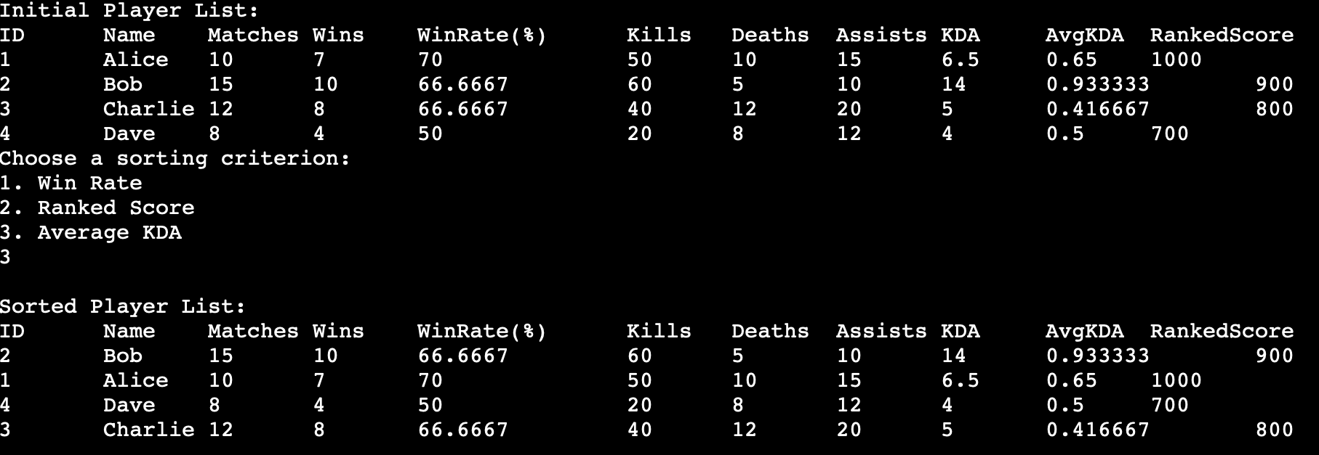
Analysis and Results
Key Findings:
Accurate real-time updates of player rankings after each match.
Player name duplicates are allowed
Player ID duplicates aren’t

Slide 6
Discussion
Implications of Findings
Ranking updates work accurately
Allowing player name duplicates might cause confusion, suggesting a need for player name validation.
Player ID duplicates should be strictly avoided, as this could create ambiguity in player data.
Project Limitations
Missing a lot of possible data from Riot API.
Could technically steal off of the existing sites though it breaks ToS.
Not optimally scalable.
File based storage is slower for larger data sets
Searching for specific players is done sequentially, which slows down as more players are added
Handle multiple players
A match history recap only accessible by one user isn’t practical
Would have to change to a web-based app such as existing solutions

Slide 7
Conclusion
Conclusions from the Project
The core ranking functionality works as expected, with players being ranked based on their league metrics.
The merge sort function also works as expected.
Recommendations for Future Work
Implement a graphical user interface (GUI) to enhance user interaction.
Provide real-time updates and feedback to the user in game with functional overlay in an intuitive visual format.
Explore additional features like sorting by more criteria or adding player statistics (detectable player patterns, timings, etc)
Make a web-based app, so that it can receive data from matches without inputting data manually, and so that it isn’t usable by literally one person.

Slide 8
References
https://www.w3schools.com/dsa/dsa_algo_mergesort.php
https://stackoverflow.com/questions/11365456/saving-and-loading-data-to-a-file-c-beginner
https://www.cplusplus.com/doc/tutorial/files/
https://stackoverflow.com/questions/54581971/fetch-real-time-data-using-riot-api-is-it-possible

